Slide 1
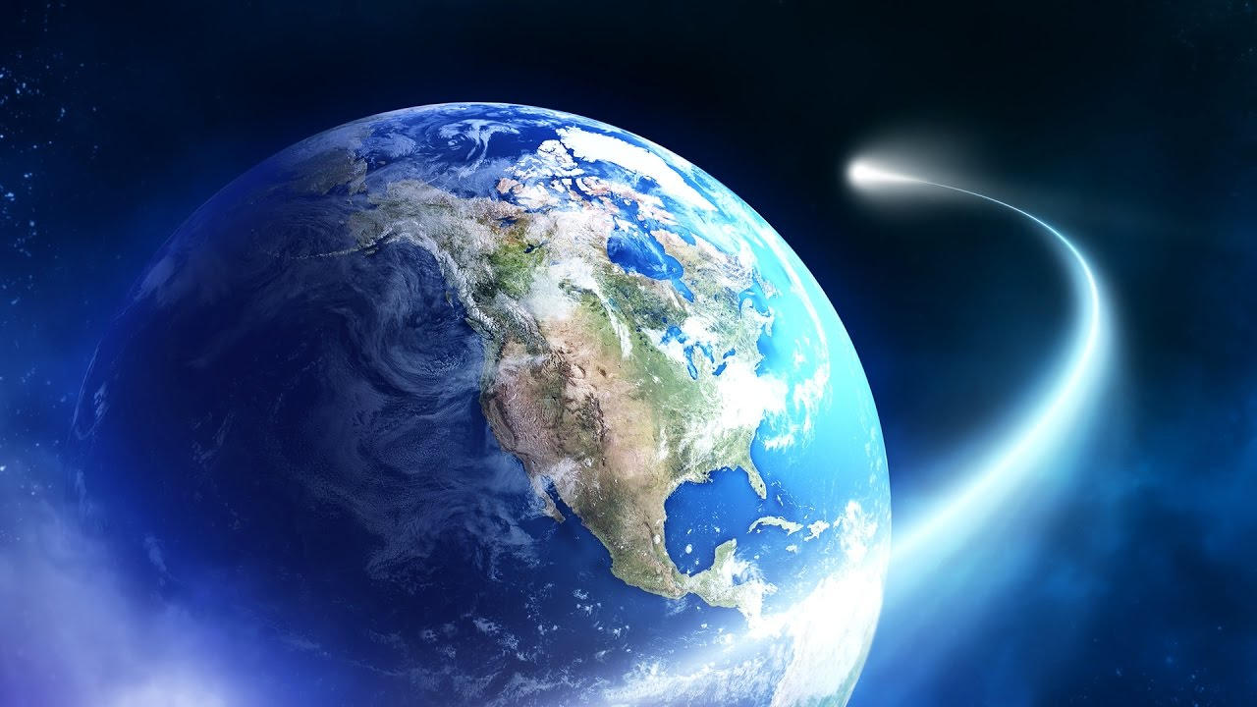
EARTH

Slide 2
SAVE OUR EARTH
I love the Earth and together we have to stop climate change. We have to stop wasting electricity and stop using soft plastics once and then throwing them away. We can use paper and cardboard and recycle them afterwards. And finally have to stop littering and use the bins we should have every where!
We have to stop climate change together!
Please enjoy my project on our beautiful Earth!

Slide 3
THE EARTHS ROTATION IS GRADUALLY SLOWING.
This deceleration is happening almost imperceptibly at approximately 17miliseconds per hundred years, although the rate at which it occurs is not perfectly uniform. This has the effect of lengthening our days but it happens so slowly that it could be as much as 140 million years before the length of a day will have increased to 25 hours!

Slide 4
HELP THIS PLANET

Slide 5
FACINATING FACTS
It takes 23 hours 56 mins 4 secs to rotate on its axis
Earth is the only planet not named after a God.
Distance from the sun is 149.6 million km.
The Earth tilts at roughly 66 degrees.
Earth has one moon.

Slide 7
EARTH HAS A POWERFUL MAGNETIC FIELD
This phenomenon is caused by the nicked iron core of the planet, coupled with its rapid rotation. This field protects the Earth from the effects of solar wind.

Slide 8
THERE IS ONLY ONE NATURAL SATELLITE OF THE PLANET EARTH
As a percentage of the size of the body it orbits the moon is the largest satellite of any planet in our solar system. In real terms however it is only the 5th largest natural satellite.

Slide 9
SHAPE
The Earth is not actually round in shape in fact it is geoid. This simply means that the rounded shape has a slight bulge towards the equator. This happens solely because the rotation of the Earth which causes the bulge.

Slide 10
THE EARTHS WATER SOURCE
Only 3% water of the Earth is fresh, rest 97% salted. Of that 3%, 2% is frozen in ice sheets and glaziers. Which means 1% water is found in lakes, rivers and underground.

Slide 11
THE EARTH WAS ONCE BELIVED TO BE THE CENTRE OF THE UNIVERSE
Due to the apparent movements of the Sun and planets in relation to their viewpoint, ancient scientists insisted that the Earth remained static , whilst other celestial bodies travelled in cinalar orbits around it. Eventually the view that the Sun was at the centre of the universe was postulated by Copernicus, though this is also not the case.

Slide 12
THE EARTH IS THE DENSEST PLANET IN THE SOLAR SYSTEM
This varies according to the part of the planet for example the metallic core is the denser than the crust. The average density of the Earth is approximately 5.52 grams per cubic centimeter.

Slide 13
Is Earth the 3rd planet from the Sun the 4th or the 5th ?
Is Earth named after a God?
How many moons does Earth have?
How long does it take for the Earth rotate?
24 hours
23h 56mins 4secs
Or 23hours 55mins 14 secs
What is the Earths distance from the Sun?
149.6 million km
148.7 million km
or 150.8 million km
TURN FOR ANSWERS

Slide 14
ANSWERS
3rd
False
1 moon
23h 56mins 56secs
149.6 million km
THANKS FOR READING MY PROJECT
By Lauren o’ Leary age 10

